Slide 1
Nordic Totalys user meeting AX-lab 6/4-22

Slide 2
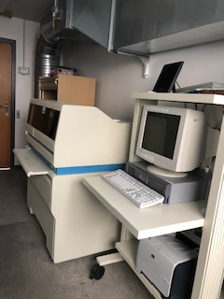
Focal Point analog from 2006
Not in use

Slide 3
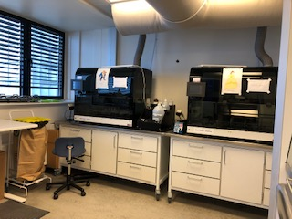
Totalys slideprep juni 2014
Urin
Vacuum
Syringe and plunger

Slide 4
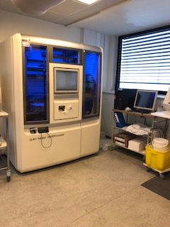
Totalys multiprocesser november 2014
Afpipetering HPV
4 characters
IO Port open
Warning HPV
Noise from elevator

Slide 5
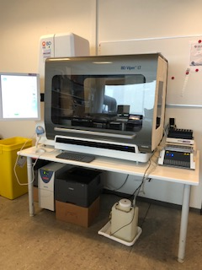
Viper nov 2018
Reading of barcode
Initializing after restart

Slide 6
Generel
Kit
EA/OG versus Hæm

