Slide 1
Totalys-system Workflow at Ahus, Norway
Anna Wittersø

Slide 2
Regional laboratory for Cervix-screening
2,6 million people
11 state hospitals
HPV primary screening age 34-69
From 10 to 3 regional laboratories in the national screeningprogram
Akershus University Hospital
Expect around 70 000 cervical samples in 2022
HPV only: 56 %
Cytology only 26 %
HPV and cytology 18 %

Slide 3
Registration
Requests:
Electronic
Paper
Integrated in the LIMS: Check patienthistory for correct workline.
HPV, Cytology or both according to national guidelines.
If co-test HPV and cytology – Cytology first
HPV primary-screening, if positive → Cytology
Normal day average:
140 HPV (primary HPV)
130 Cytology (co test and primary cytology)

Slide 4
Linking C-tube – SurePath-vial
Extra label for C-tubes printed during registration.
Sample-ID, Patient-ID, QR-code and workitem (decides HPV, Cytology or both)
C-tubes labeled when loading the tray
Link the Sample-ID to the C-tube-ID by scanning both QR-codes on remote station.

Slide 5
MultiProscessor
Printing of slides programmed in datalink
When proscessing the samples in MultiProscessor the slide print is activated.
You always have the right slides for the batch
Possible to reprint if problem with the printer during printing (bad print etc).

Slide 6
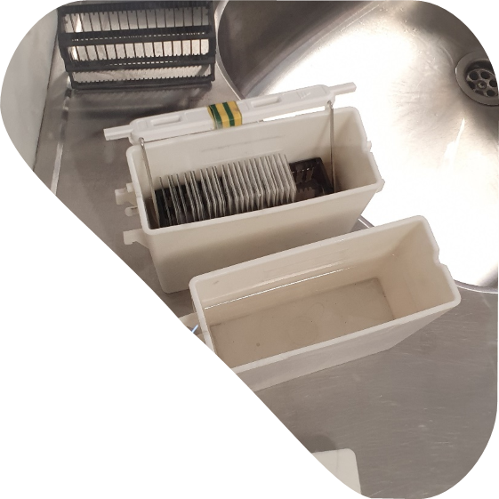
SlidePrep -
Slideprep
2 instruments if many samples
After rinsing - xylen
Coverslipping – Leica Spectra

Slide 7
Check each slide – rerun?
All slides are checked macorscopic
If it looks scant - we check in microscop and order rerun with 800 µl if few sqamous cells. Both slides are screened.
Picture:
left slide – rerun
right slide ok
Airbubbles? Remove coverslip and cover again (manually)

Slide 8
Scanning in FocalPoint
All slides, but slides that need rerun or Cito-samples are going directly to screening.
Scanning overnight

Slide 9
Screening
Guided screening - focalpoint
Not all samples
Ergonomic challenge for some screeners
Many slides have HPV testing and need rescreening
Screeninghistory – access to history in national cancer-register
Symptoms, clinical information and HPV-status
Rescreening
Symptoms
HPV positive
Other reasons

Slide 10
Digital imaging
Regional prosess for regional solution
Histology first
Need scanning in different focus for cytology
No plans for digital imaging on cytology the next years

Slide 11
Improvements?
Multiprocessor
Check for syringes before processing
Sensor for measuring density reagent and trisbuffer remaining

Slide 12
Thank you!

